Slide 1

A Survey：
How to Better Fine-tune Pre-trained Language Models
THUNLP Yusheng Su
2021.07.14

Slide 2
Development of PLM
Pretrain-then-finetune becomes a standard
Notes:
先Pre-train先學知識，再透過fine-tune將知識transfer到下游任務。Pretrain-then-finetune is a standard for PLMs to utilize in NLP。
在Large PLM出現後，近幾年，fine-tune技術在NLP model廣泛被使用。

Slide 3
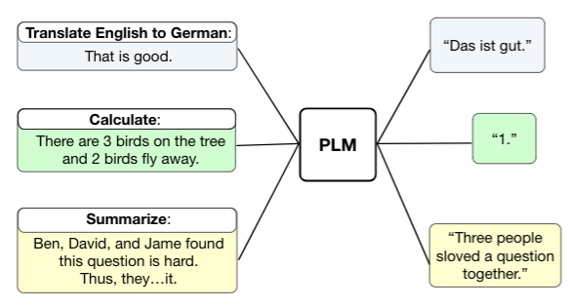
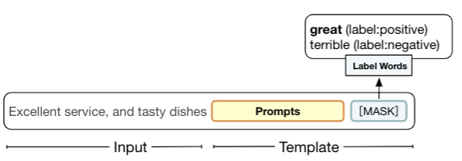
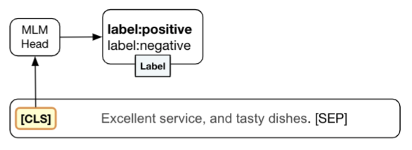
Fine-tuning Strategies of PLMs
Task-specific Head Tuning
Seq2Seq Tuning
Prompt Tuning
Notes:
Task-spec: MLM
Seq2seq: T5
Prompt: MLM, GPT3

Slide 4
Recently, the size of PLMs becomes larger
Present fine-tuning strategies may result in the limitation of adopting larger PLMs to downstream tasks
Notes:
模型越來越大，但並不是模型越大下游任務表現就會越好，我們認為是因為fine-tune的技術，限制的大模型的性能。

Slide 5
Challenges in Fine-tuning of PLMs
Notes:
針對這五個模組，給出相對應解決方式/方向。

Slide 6
Challenges in Fine-tuning of PLMs

Slide 7
Input | Parameter | Objective | Optimization | Robustness
Challenges:
Need rich and high-quality annotated data
Have difficulty comprehensively understanding languages like humans
Methods:
Downstream Level Information Augmentation
Ability Augmentation
Notes:
1. 即使PLM能力很強，在標記數據缺少的情況下依然不好。
2. 即使數據量夠，模型缺乏high-level知識依然無法表現好。

Slide 8
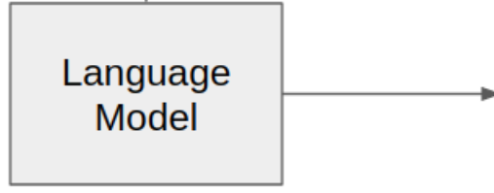
Input | Parameter | Objective | Optimization | Robustness
Challenges:
Need rich and high-quality annotated data
Have difficulty comprehensively understanding languages like humans
Methods:
Downstream Level Information Augmentation
Domain-level
Task-level
Training on domain-level data (unlabelled) by pre-training objective (MLM).
Training on task-level data (labeled, pseudo labeled)
by data augmentation or auxiliary training objectives (Ex. Supervised Contrastive Learning)
Notes:
輔助任務如:supervised contrastive learning
相同label的instance靠近，不同的遠離。

Slide 9
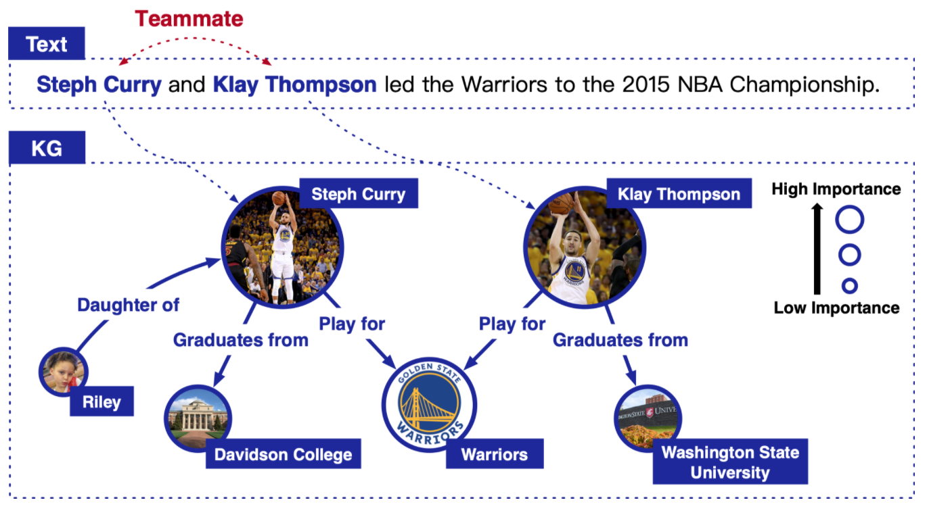
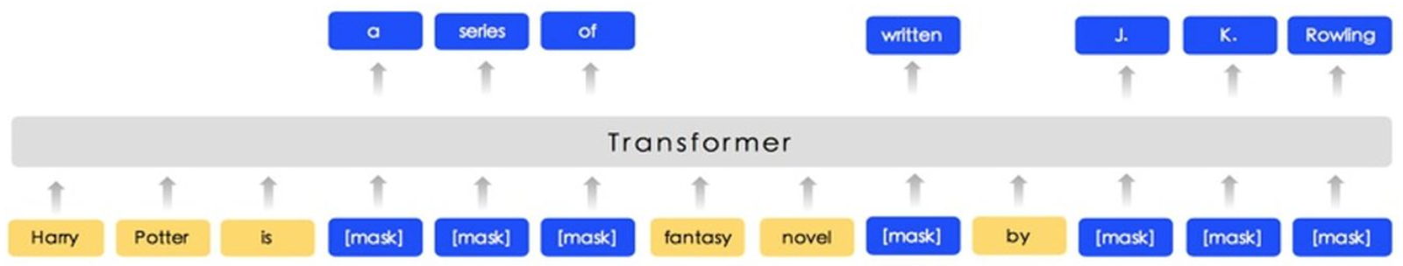
Input | Parameter | Objective | Optimization | Robustness
Challenges:
Need rich and high-quality annotated data
Have difficulty comprehensively understanding languages like humans
Methods:
Ability Augmentation
SpanBert, ERNIE, KEPLER, KnowBert, CokeBERT, …
Notes:
研究者在大量的任務數據上做實驗，得到一個結論：High-level的知識，如NLI (推理)、知識圖譜，有助於model在下游任務的表現

Slide 10
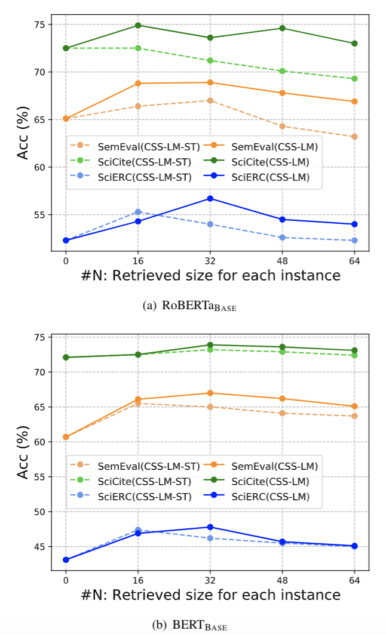
Unstructured data
MLM training, Extra representation incorporating
Structured data
Data Augmentation +
(Fine-tuning/Contrastive learning)
Findings and Questions:
How to learn ?
[Su et al., 2021]
Notes:
需設計不同的學習方式：
Unstructured data: 參考上一頁，用MLM的方式，或是將表示遷入模型
Data Augmentation 數據不一定品質夠好 (Fine-tuning/Contrastive learning)，此時使用Contrastive learning可能更有效

Slide 11
Challenges in Fine-tuning of PLMs

Slide 12
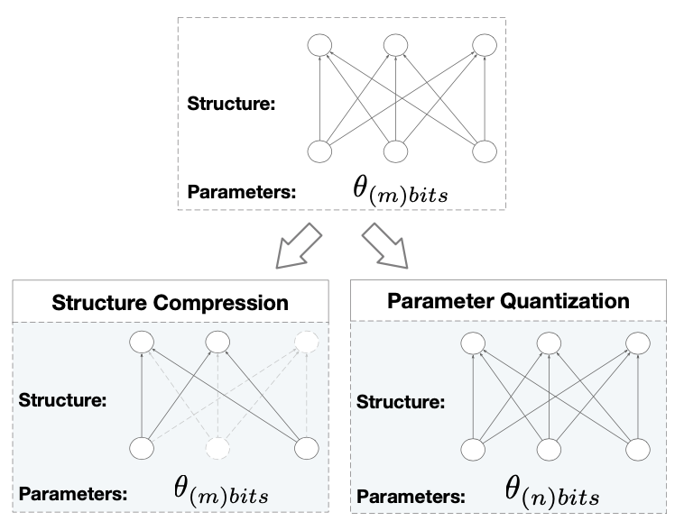
Input | Parameter | Objective | Optimization | Robustness
· Challenges: (in resource-constrained)
Sparse structural
A large size of parameters
· Methods:
Structure Compression
Parameter Quantization
Notes:
Sparse structural：當對於模型做fine-tune時，發現隨機擾動高層的參數，對於模型表現結果毫無影響。表示PLM是一個很sparse的架構，很多無用的參數。

Slide 13
Input | Parameter | Objective | Optimization | Robustness
· Challenges: (in resource-constrained)
Sparse structural
A large size of parameters
· Methods:
Structure Compression
Pruning
Distillation
Notes:
剪枝：丟掉一些對下游任務無用的head
蒸餾：大模型到小模型

Slide 14
Input | Parameter | Objective | Optimization | Robustness
· Challenges: (in resource-constrained)
Sparse structural
A large size of parameters
· Methods:
Parameter Quantization
Quantization
Notes:
壓縮精度

Slide 15
Challenges in Fine-tuning of PLMs

Slide 16
Input | Parameter | Objective | Optimization | Robustness
· Challenges:
Cannot well dispatch parameters stored task-specific knowledge for the corresponding task
Discrepancy between pre-training and fine-tuning stages
· Methods:
Pre-trained Parameter Sharing
Task-specific Prompt Tuning
Notes:
大PLM有足夠的knowledge，為何模型越大，下游任務無法同時增大
無法有效調度參數
Pre-training 和 fine-tuning objective 差距太大。[mask]某一個詞，用上下文直接預測[mask]。在fine-tunet時，插入[CLS]使用上下文產生[CLS]emb，然後再去做分類任務。

Slide 17
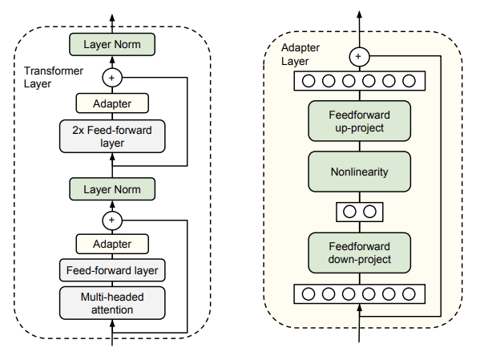
Input | Parameter | Objective | Optimization | Robustness
· Challenges:
Cannot well dispatch parameters stored task-specific knowledge for the corresponding task
Discrepancy between pre-training and fine-tuning stages
· Methods:
Pre-trained Parameter Sharing
Adapter
Notes:
只訓練adapter (feedward layer)<只要存adapter參數。在inference階段時，用跟task相對應的adapter

Slide 18
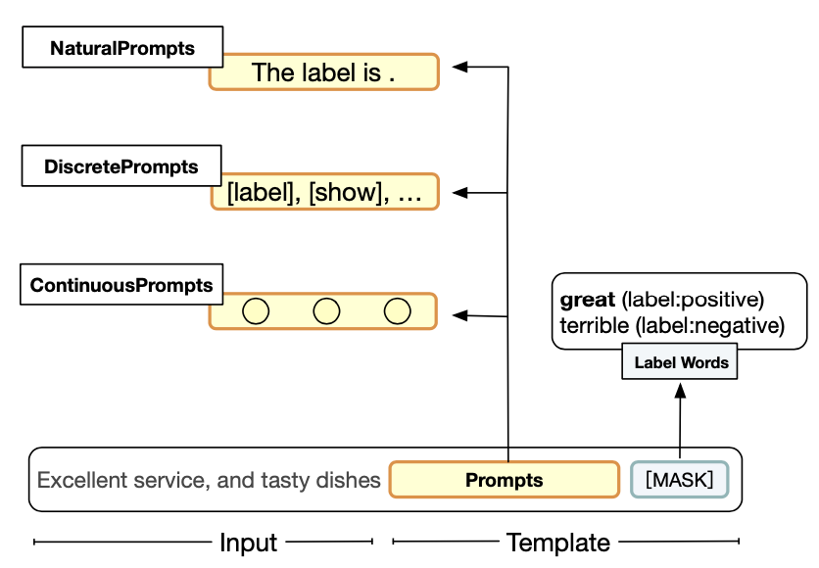
Input | Parameter | Objective | Optimization | Robustness
· Challenges:
Cannot well dispatch parameters stored task-specific knowledge for the corresponding task
Discrepancy between pre-training and fine-tuning stages
· Methods:
Task-specific Prompt Tuning
NaturalPrompts
DiscretePrompts
ContinuousPrompts
Notes:
- MLM模型上，pre-train和fine-tune有差異。把下游任務改成MLM的template。
例如原本是加[CLS] token，然後crossentropy當成分類任務訓練。現在給一個prompt生成mask。 這邊的方式說明如何優化prompt
parameter-effficient, data-efficient, time-efficient, ….被用在GPT, T-5上等…
以往prompt tuning 在few-shot場景有效。現在在many shot也能見效。Ex. P-tuning, PTR旭爺工作
有一些證明工作說明prompt的有效性

Slide 19
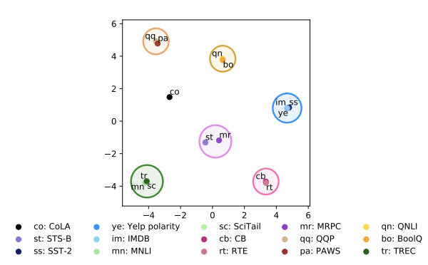
- Transformability:
Findings and Questions:
Adapter
Sentiment classification
[Mahabadi et al., 2021]
- Superimposition:
[[1,0,1],
1,0,1]]
+
=
[Guo et al., 2021]
Parameter-efficient Multi-task Fine-tuning for Transformers via Shared Hypernetworks, Mahabadi et al., 2021, arXiv Parameter-Efficient Transfer Learning with Diff Pruning, Guo et al., 2021, arXiv
Notes:
假設：如果task, domain相似，adapter會相。
Adapter的遷移性，有實驗分析adapter的embedding表示，相同的任務會貼近。將同task的adapter拿到其他的task上去用
Adapter的疊加性，根據不同的任務產生不同的trained的adapter (Diff)，再做fine-tune。測試是否能疊加使用

Slide 20
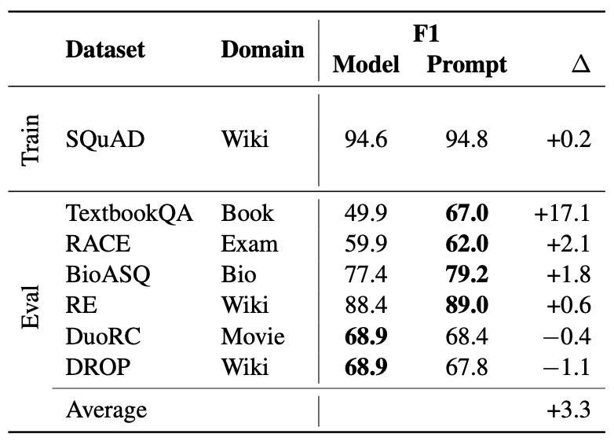
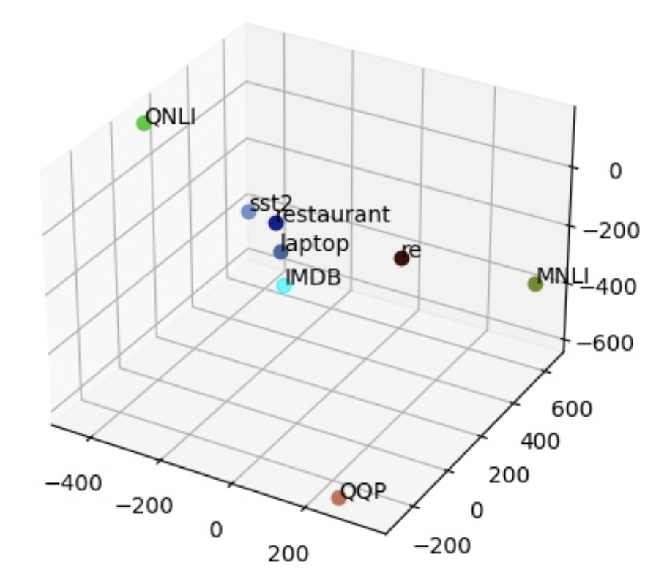
Transformability:
(Domain level) [Lester et al., 2021]
(Task level) [Ongoing]
Findings and Questions:
Prompt
The Power of Scale for Parameter-Efficient Prompt Tuning, Lester et al., 2021, arXiv
Notes:
架設：如果task, domain相似，prompt會相似。
如何刻畫prompt, adapter的相似度是個問題（transfer到第三個task看表現，還是投射到低維）

Slide 21
Transformability:
(Domain level) [Lester et al., 2021]
(Task level) [Ongoing]
(Model-size level) [Ongoing] by Yi
It works
Findings and Questions:
Prompt
- Superimposition: [Future investigation]
The Power of Scale for Parameter-Efficient Prompt Tuning, Lester et al., 2021, arXiv

Slide 22
Challenges in Fine-tuning of PLMs

Slide 23
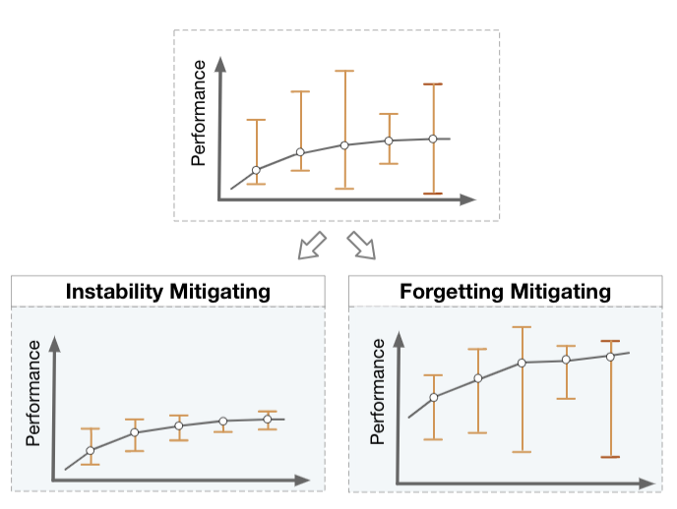
Input | Parameter | Objective | Optimization | Robustness
· Challenges:
Differ dramatically for different runs
Forget the knowledge learned in the pre-trained stage
· Methods:
Instability Mitigating
Forgetting Mitigating

Slide 24
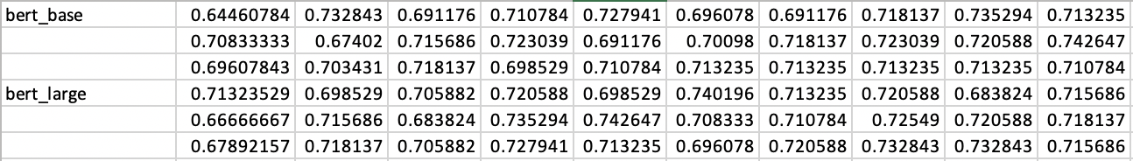
Input | Parameter | Objective | Optimization | Robustness
· Challenges:
Differ dramatically for different runs
Forget the knowledge learned in the pre-trained stage
· Methods:
Instability Mitigating
Data Augmentation
Iteration Augmentation
Standard Optimizer Training
Glue: MRPC (Few-shot setting)
Base- mean: 0.7125, var: 1.9e-4 | Large - mean: 0.7089, var: 4.1e-4
Notes:
大模型比小模型不穩定
A non-standard optimizer to train PLMs (BERT modified AdamW optimizer omitting a bias correction step), which has similar effect as the learning rate warmup.

Slide 25
Input | Parameter | Objective | Optimization | Robustness
· Challenges:
Differ dramatically for different runs
Forget the knowledge learned in the pre-trained stage
· Methods:
Forgetting Mitigating
Parameter Regularization
Schedule Designing
Gap Narrowing (Domain-level, prompt)
Notes:
Parameter Regularization：加入約束項，避免fine-tune完後的參數離pre-train太遠
Schedule Designing: 給模型每層參數不同learning rate, freeze所有層，慢慢unfreeze每層

Slide 26
Challenges in Fine-tuning of PLMs

Slide 27
Input | Parameter | Objective | Optimization | Robustness
· Challenges:
Bias
Attacks
· Methods:
Debiasing Fine-tuning
Adversarial Fine-tuning
Notes:
學習到bias，或是被攻擊。導致魯棒性差

Slide 28
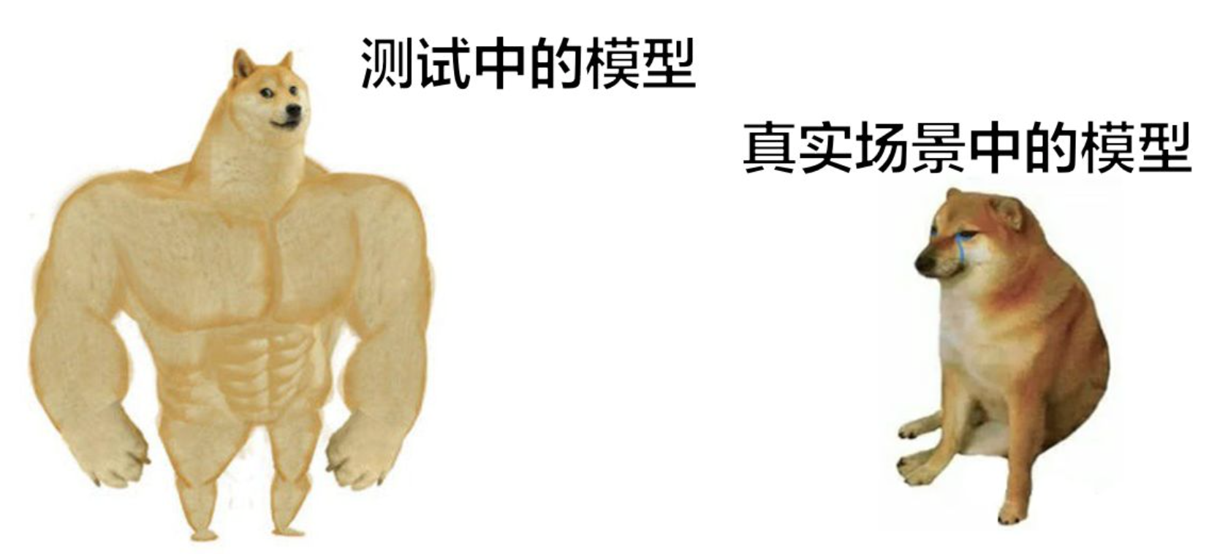
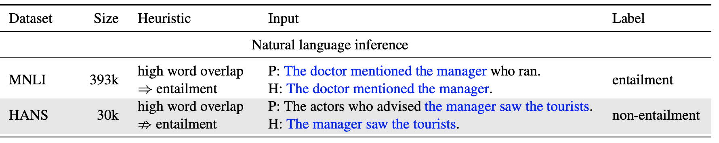
Input | Parameter | Objective | Optimization | Robustness
· Challenges:
Bias
Attacks
· Methods:
Debiasing Fine-tuning
Instance Re-weighting
Minority Example Training
Spurious correlations in the dataset (Trad-off: Accuracy vs. robustness)
Notes:
- Re-weighting:用先驗知識判斷bias example and lower weights (a classifier to classify bias or non-bias)
- Minority: Fine-tune效果會好可能是利用了：偽關係 (Spurious relationship)，ice cream, swim, summer。 Hard to generalize
Minority example: 如上圖，類似一種Data Aug方式，加入相反信息(Minority example); 進階方式：automatically detect minority example

Slide 29
Input | Parameter | Objective | Optimization | Robustness
· Challenges:
Bias
Attacks
· Methods:
Adversarial Fine-tuning
Embedding Perturbation
Word Substitution
Loss Regularization
[Attack]
Notes:
Embedding Perturbation：對輸入的word embedding 做擾動
Word Substitution: 但現實的攻擊模型的是自然語言，對離散的文字作擾動
Loss Regular：加入正则項

Slide 30
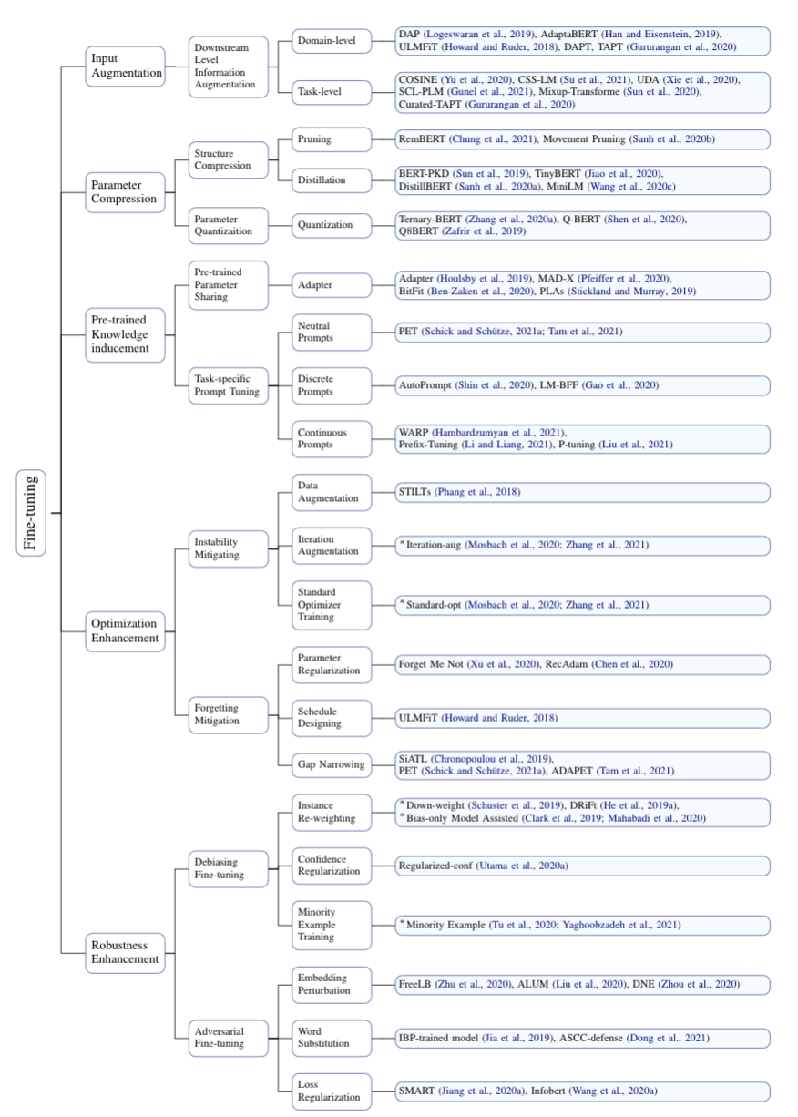
A Survey:
How to Better Fine-tune Pre-trained Language Models
Conclusion
Just my two cents:
”Prompt and Adapter seem to be powerful, which can mitigate the issues in every module to some degree.”
Please refer to the paper for more detail

Slide 31
Input:
How to learn? (P.10)
Objective
Transformability and Superimposition for Prompt and adapter (P.19)
Extra
Fine-tuning is still a standard for PLMs?
Open Question and Discussion

